Slide 1

WP2
Main activities conducted
Inclusion of the “human dimension” of science and the values embedded in RRI in performance-based activities
Design of six Exploratory Workshops
Delivery of the EW in Spain, UK and France
Collection and analysis of EW discussions
Generation of an integrated PERformance-based Science Education and Innovative Activities (PERSEIA)
Design of three PERSEIAs, one per each Case Study
Delivery of the three PERSEIAS to more than 1800 students
Participatory process with young people, teachers and early career researchers
Design of the Participatory Process General Implementation
Contact with schools and coordination of the Participatory Process General Implementation
Design of the six Participatory Workshops
· PERFORM Consortium Meeting. Paris, November 9th, 2016 ·

Slide 2
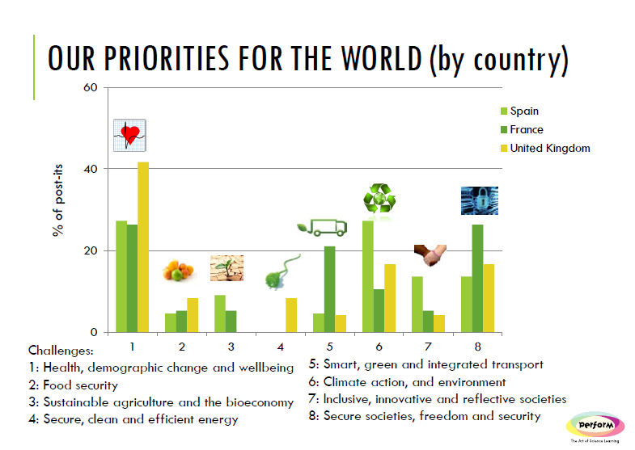
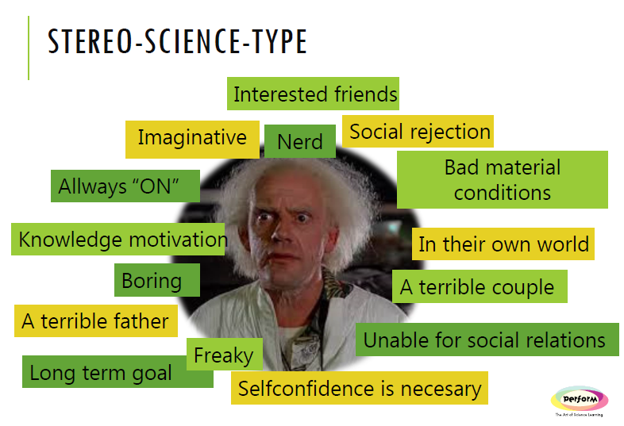
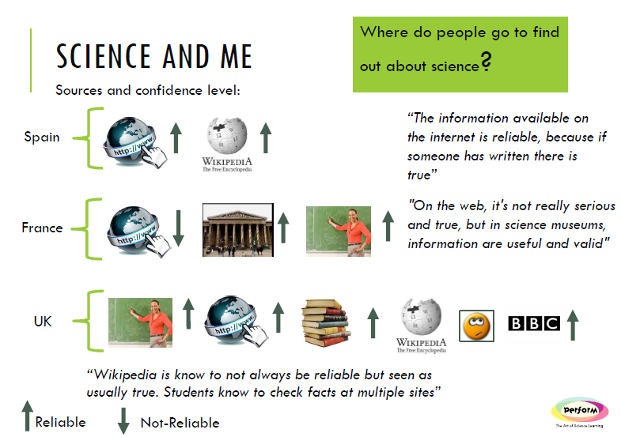
WP2
Main outputs achieved
An integrated PERformance-based Science Education and Innovative Activities protocol
· PERFORM Consortium Meeting. Paris, November 9th, 2016 ·

Slide 3
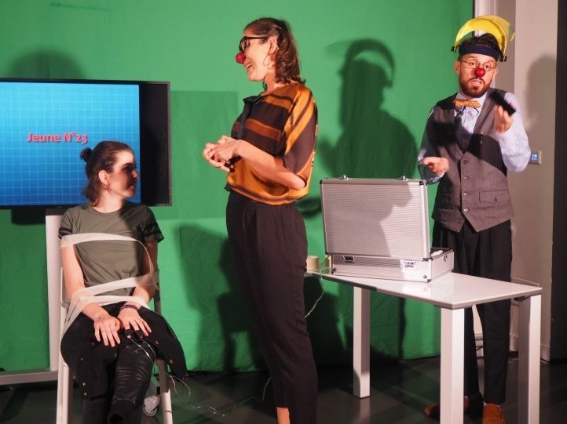
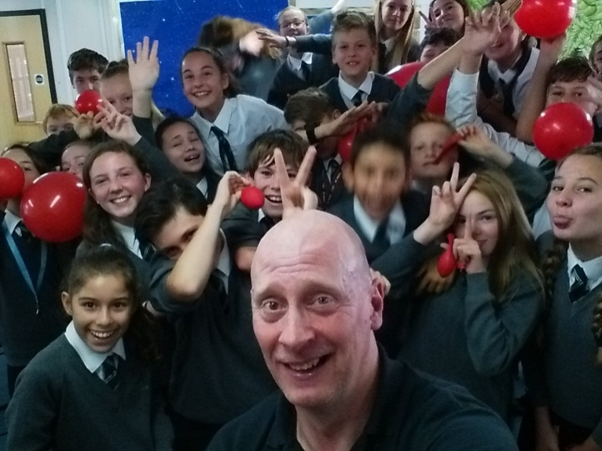
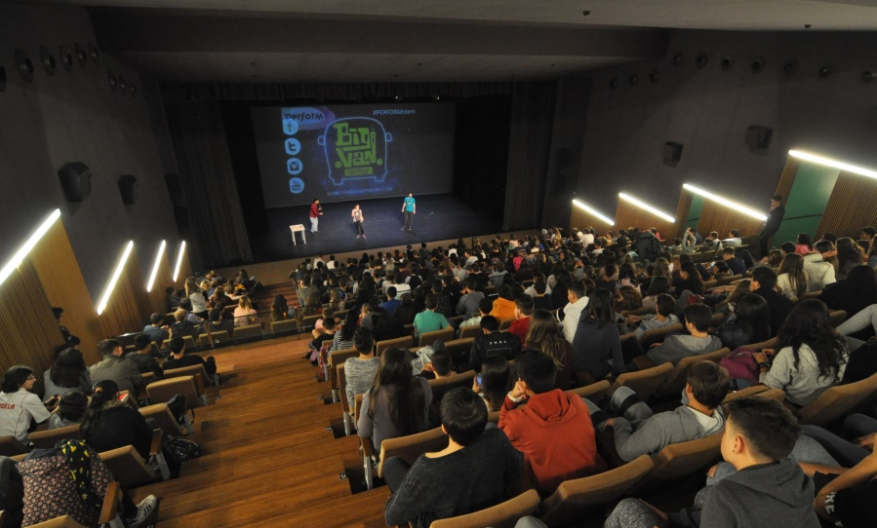
WP2
Main outputs achieved
Three PERformance-based Science Education and Innovative Activities
  Clown in France
  Busking in UK
  Stand-up in Spain
· PERFORM Consortium Meeting. Paris, November 9th, 2016 ·

Slide 4
WP2
Next activities until Month 18
Deliverable 2.1: Final protocol of tested methods to transform a performance-based activity into a PERSEIA
Designing of the Participatory Workshops
Implementation of the Participatory Process in Spain, UK and France
· PERFORM Consortium Meeting. Paris, November 9th, 2016 ·

Slide 5
WP2
Identified challenges
PERSEIAs assessment
  Collection of students responses
Implementation of Participatory Process
  Teachers lack of time
in UK:
  Manchester / Bristol
  Social Media and online platforms
· PERFORM Consortium Meeting. Paris, November 9th, 2016 ·

