Slide 1


· Leonardo Alfonsi
Eusea project officer Perform Project
· PERFORM Consortium Meeting. Paris, November 9th, 2016 ·

Slide 2
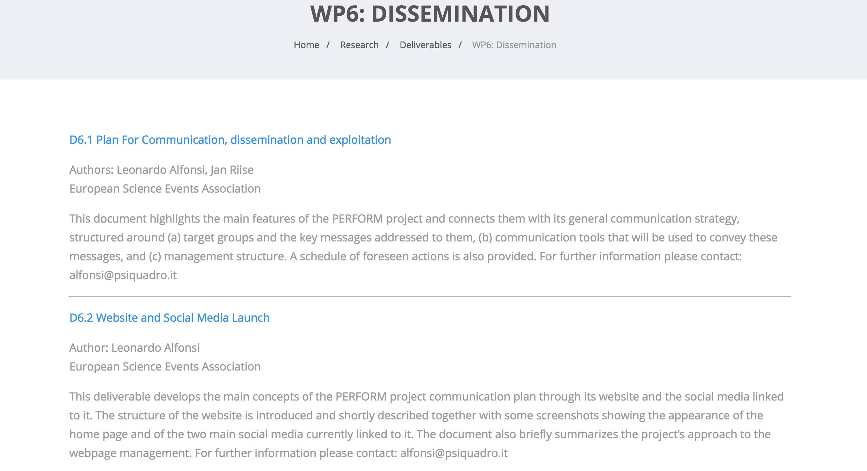
WP6
Main activities conducted
· PERFORM Consortium Meeting. Paris, November 9th, 2016 ·

Slide 3
WP6
Main activities conducted
D 6.1 Off line dissemination
Participation in Science Communication conferences
April to June
HEIRRI meeting – Target group
TEMI conference – Target group Teachers
PCST Conference – Target group sceince communicators
EUSEA Annual Conference – Target group: sceince communicators
RRI Tools conference in Milan - Target group: teachers, policy makers
RRI National contact points events in Bruxelles: Target group: decision makers at European level,
Submission of proposals to present the Perform project
during conferences
ECSITE Conference – Target group science communicators/Museum professionals
· PERFORM Consortium Meeting. Paris, November 9th, 2016 ·

Slide 4
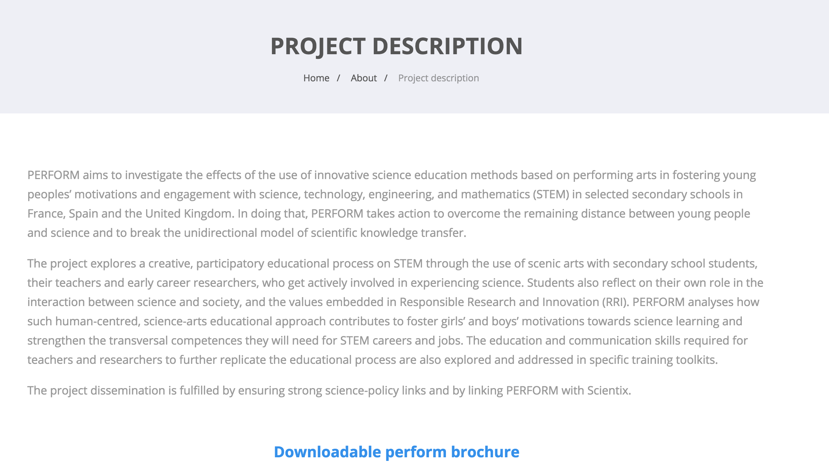
WP6
Main activities conducted
D 6.1 Off line dissemination
Production of printed material – Perform Brochure (200 copies)
· PERFORM Consortium Meeting. Paris, November 9th, 2016 ·

Slide 5
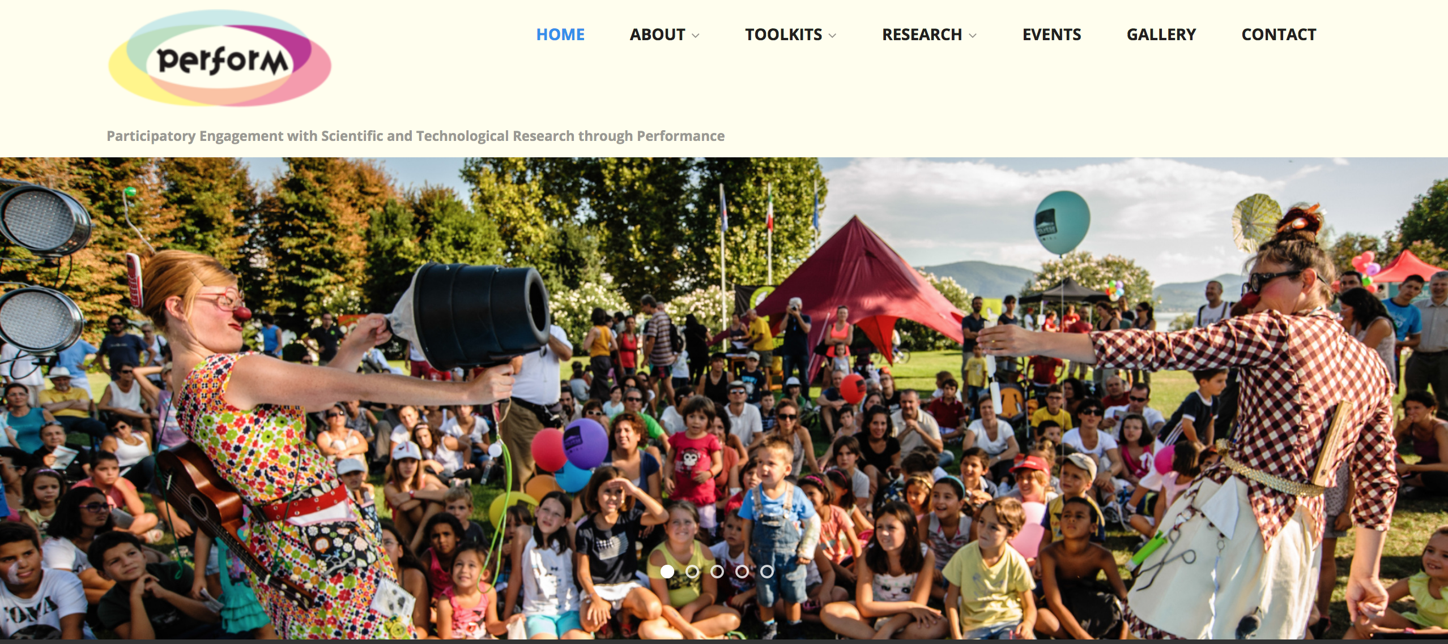
WP6
Main activities conducted
D 6.2 Online dissemination
· PERFORM Consortium Meeting. Paris, November 9th, 2016 ·

Slide 6
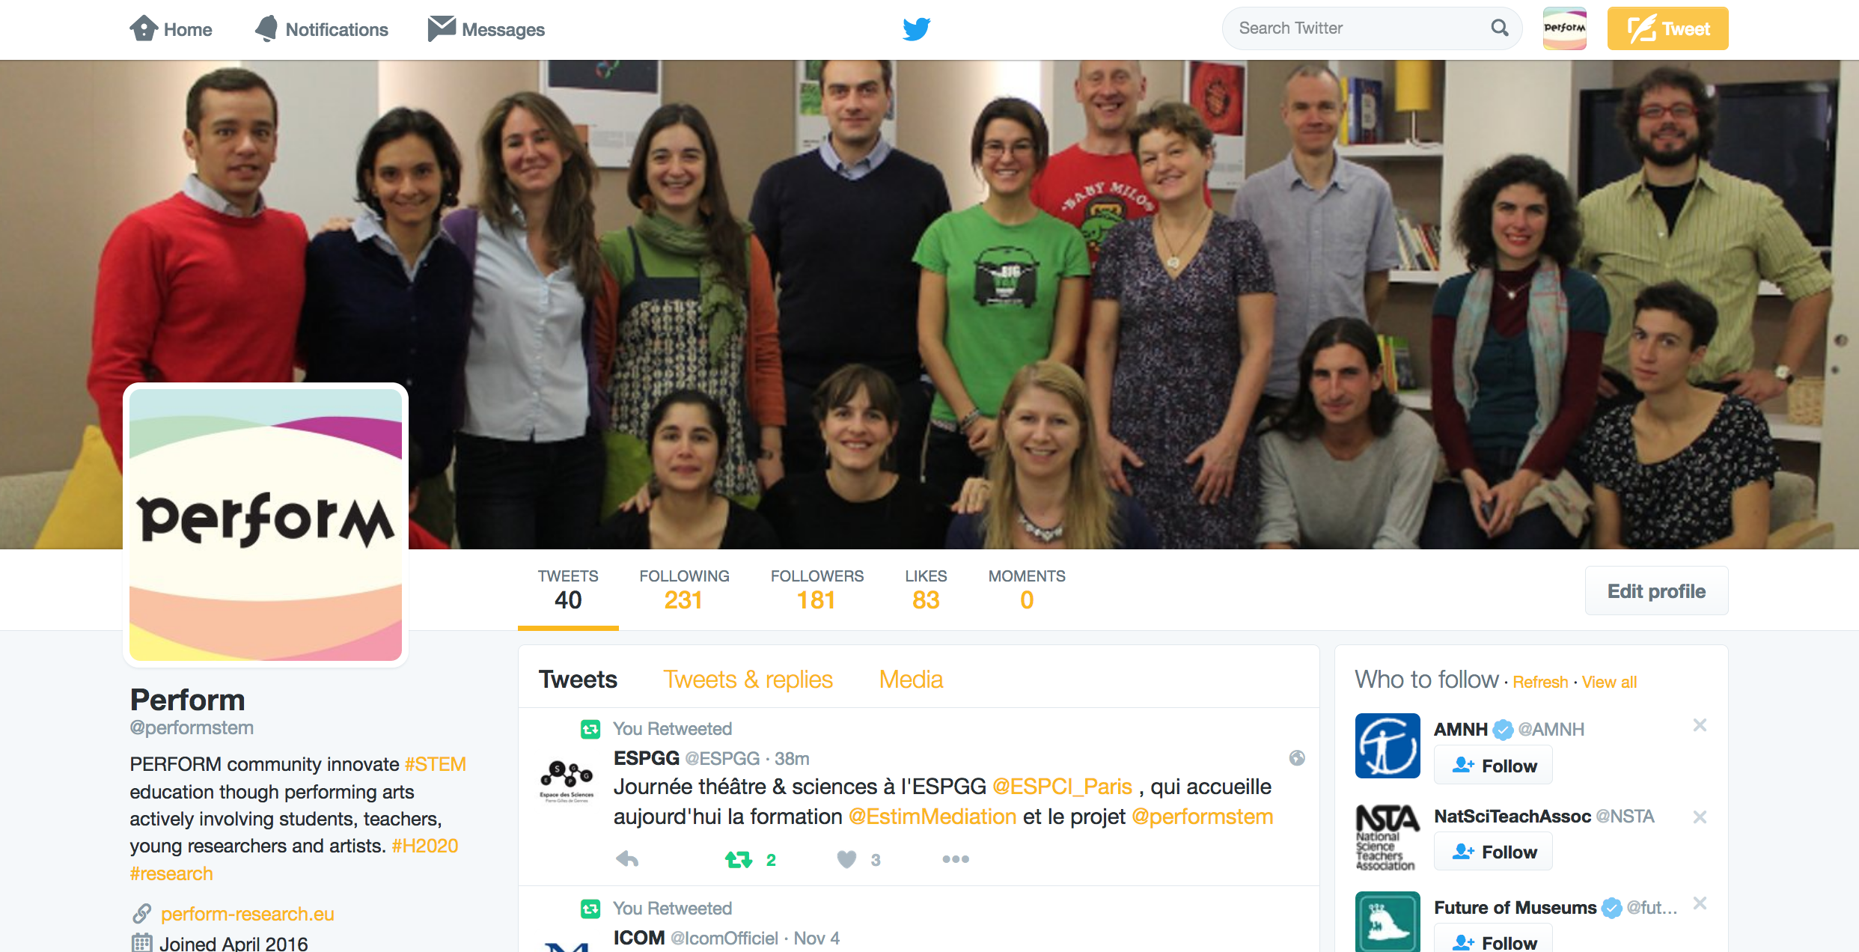
WP6
Main activities conducted
D 6.2 Online dissemination
· PERFORM Consortium Meeting. Paris, November 9th, 2016 ·

Slide 7
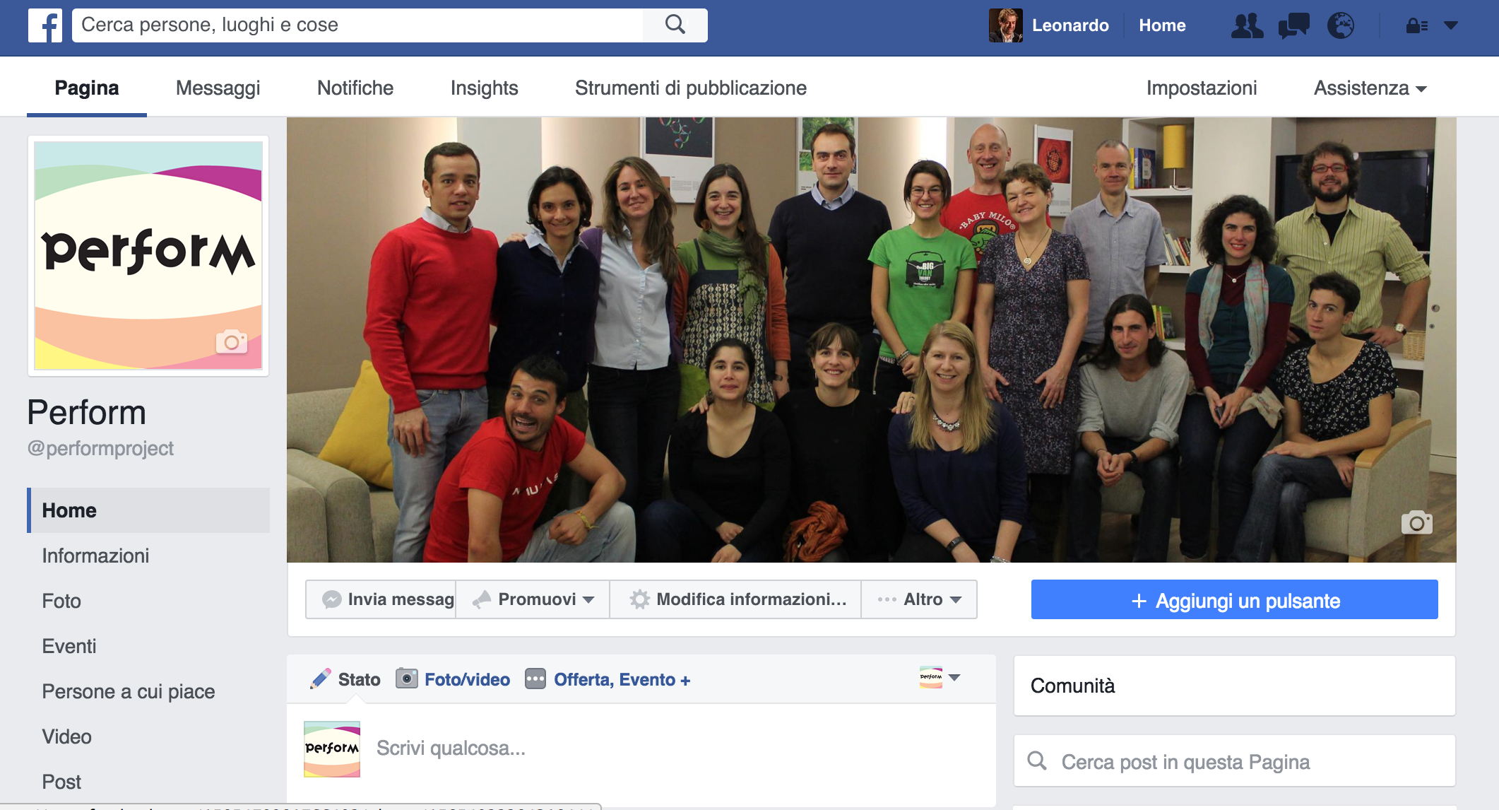
WP6
Main activities conducted
D 6.2 Online dissemination
· PERFORM Consortium Meeting. Paris, November 9th, 2016 ·

Slide 8
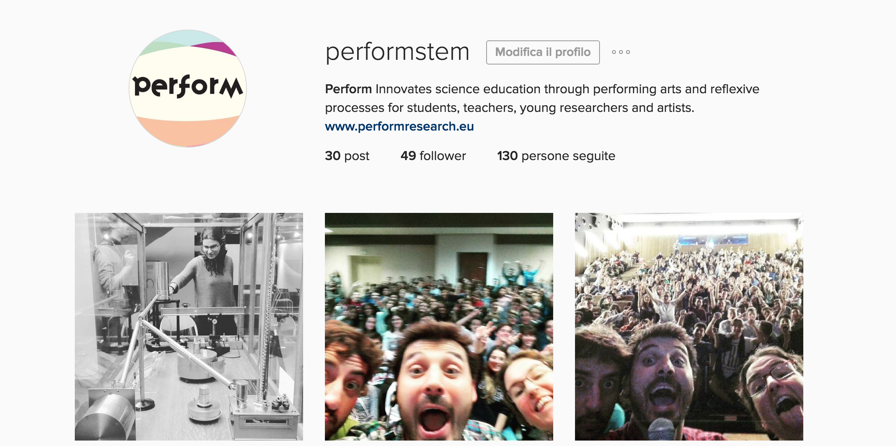
WP6
Main activities conducted
D 6.2 Online dissemination
· PERFORM Consortium Meeting. Paris, November 9th, 2016 ·

Slide 9
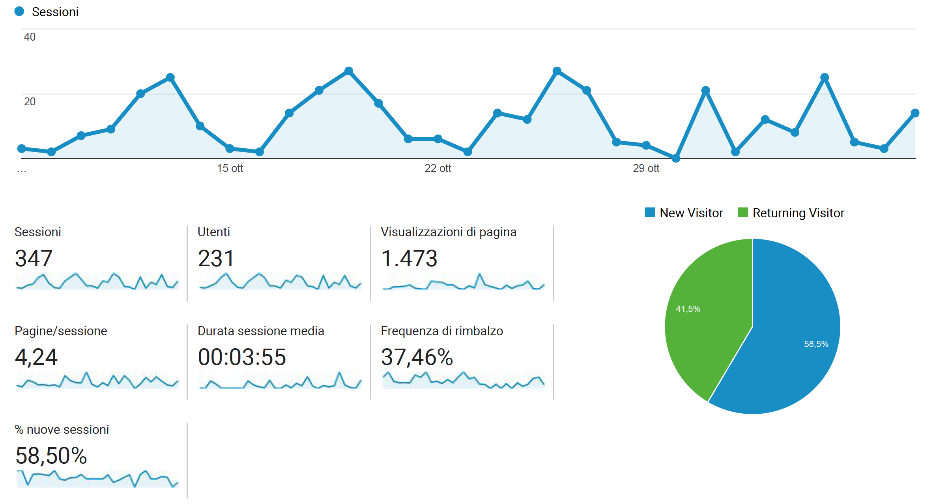
WP6
Main outputs achieved
Website data 8 Oct – 7 Nov
· PERFORM Consortium Meeting. Paris, November 9th, 2016 ·

Slide 10
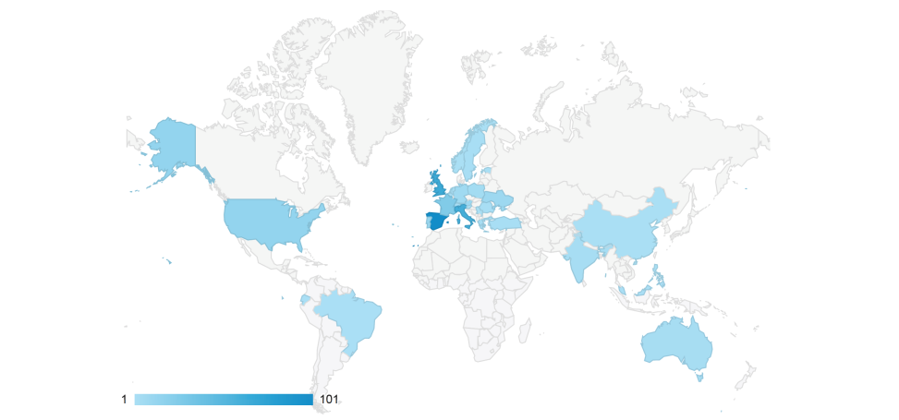

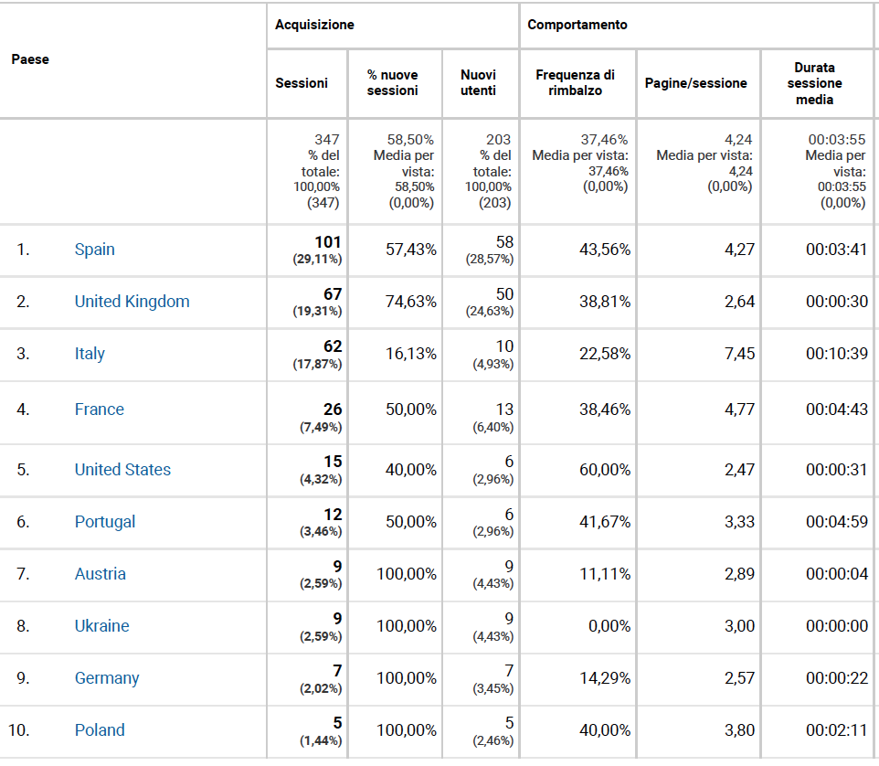
WP6
Main outputs achieved
Website data 8 Oct – 7 Nov
· PERFORM Consortium Meeting. Paris, November 9th, 2016 ·

Slide 11
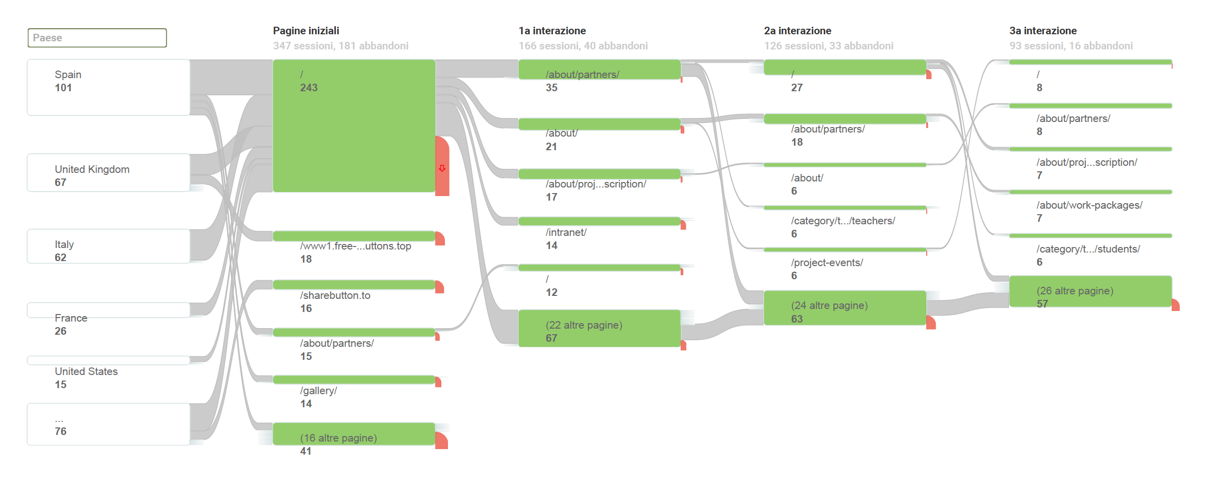
WP6
Main outputs achieved
Website data 8 Oct – 7 Nov
· PERFORM Consortium Meeting. Paris, November 9th, 2016 ·

Slide 12
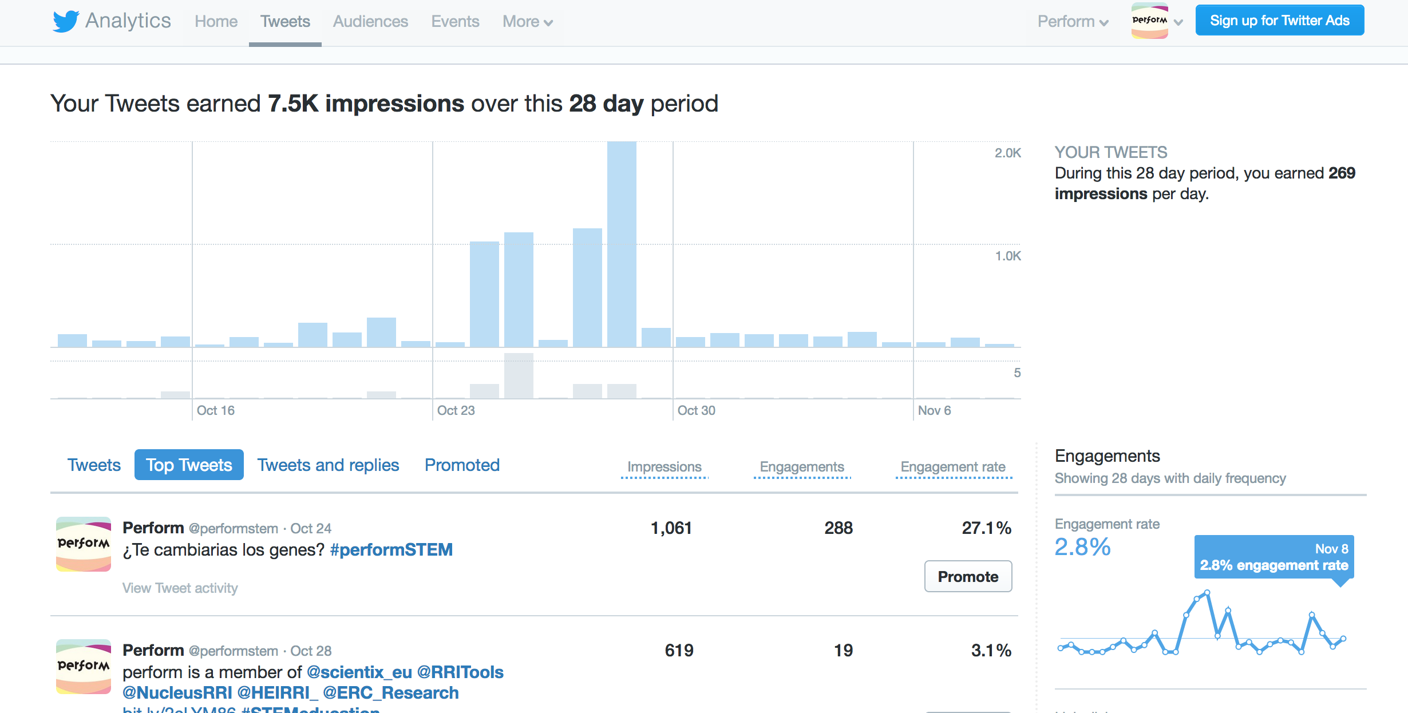
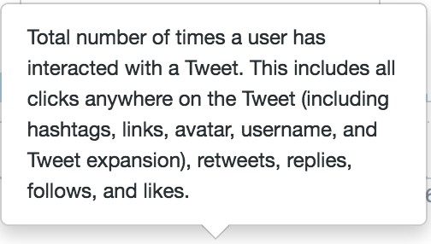
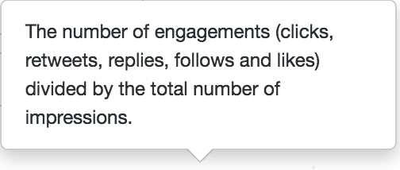
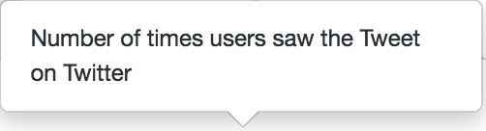
WP6
Main outputs achieved
Twitter
· PERFORM Consortium Meeting. Paris, November 9th, 2016 ·

Slide 13
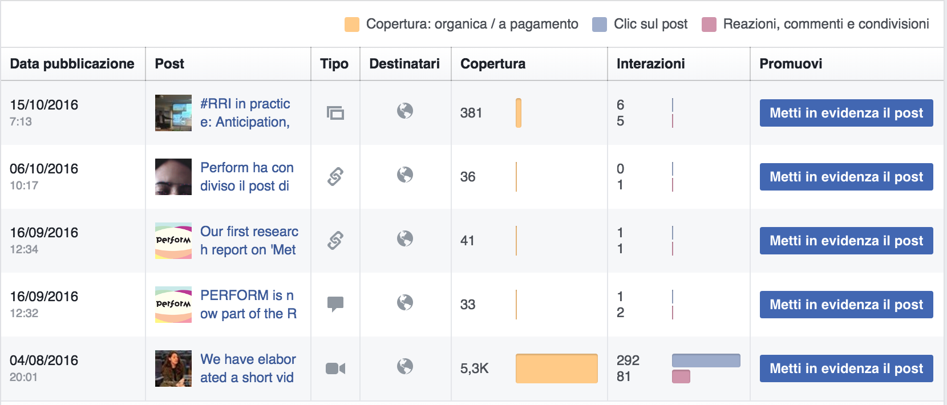
WP6
Main outputs achieved
Facebook
· PERFORM Consortium Meeting. Paris, November 9th, 2016 ·

Slide 14
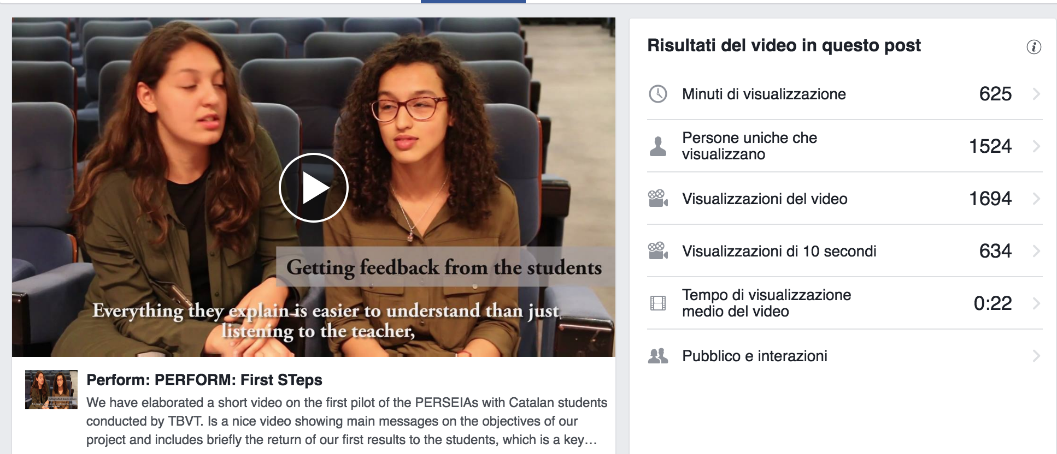
WP6
Main outputs achieved
Facebook
· PERFORM Consortium Meeting. Paris, November 9th, 2016 ·

Slide 15
WP6
Next action till M18
Off line dissemination actions
Increasing the number of connections with stakeholders
Participation in science communication events with the Perform logo
Defining common actions with other projects and networks (NUCLEUS, HEIRRI,...MCAA, ERN2017)
On line dissemination actions
Constant editorial actions
News collection implemented by the coordinator
Constant dialogue with partners to identify potential news
Increasing information on research results
Increasingly publish information about toolkits, observations. Consider the production of possible ad hoc communication material
· PERFORM Consortium Meeting. Paris, November 9th, 2016 ·

Slide 16
WP7
Identified challenges
Implementing cooperative actions
Simple but constant actions implemented by all the partners
Consider the use of videos or other communication materials
Following commong guidelines to publish on different social media
Relevant news :
Highlights an example of how a crucial concepts for the project is implemented
Tags potential stakeholders
Has a relevant pictur that stresses the concept
· PERFORM Consortium Meeting. Paris, November 9th, 2016 ·

